Slide 1

© 2011. All Rights Reserved

Slide 2
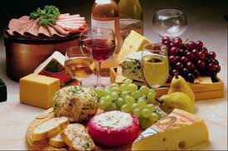
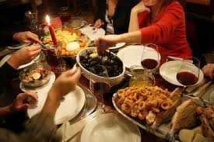
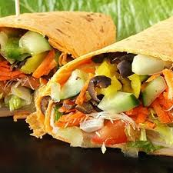
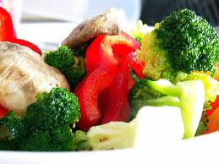
We all love food!
© 2011. All Rights Reserved

Slide 3
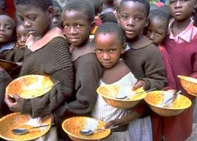
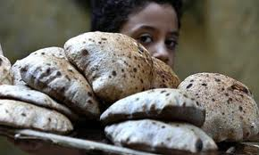
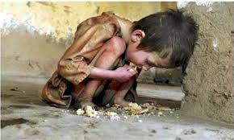
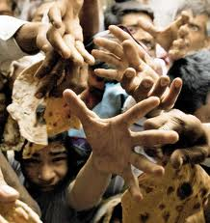
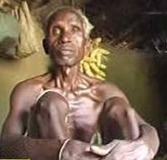
They Also Love Food!
But unfortunately, they don’t get enough of it!
© 2011. All Rights Reserved

Slide 4
Can
“WE”
do
“SOMETHING”
for them?
© 2011. All Rights Reserved

Slide 5
!!!YES!!!
‘WE CAN’
~ Just A Few Simple Steps To Be Taken!
© 2011. All Rights Reserved

Slide 6
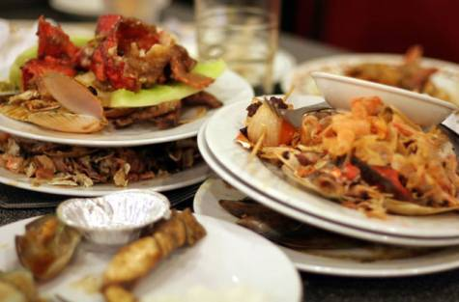
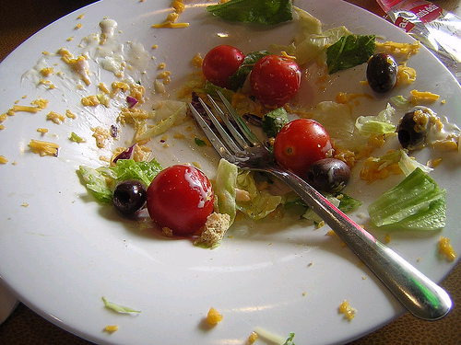
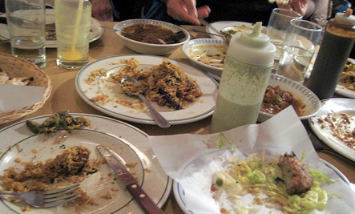
At times, We all do this!
© 2011. All Rights Reserved

Slide 7
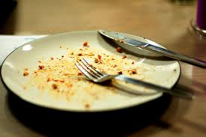
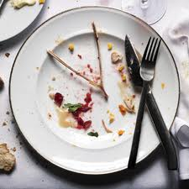
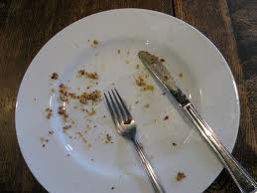
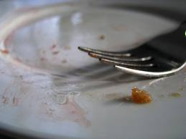
We can do LOTS, IF we can just do this much!
EAT RIGHT!
DO NOT WASTE FOOD!
© 2011. All Rights Reserved

Slide 8
SIMPLE PLEDGE:
DO NOT
WASTE FOOD ‘EVER’
&
‘DONATE MEALS’
(Donate to genuine needy, whenever you can!)
YOU READY?
© 2011. All Rights Reserved

Slide 9
!!!ONE BREAKTHROUGH STEP!!!
© 2011. All Rights Reserved

Slide 10
OUR MOTTO!
© 2011. All Rights Reserved

Slide 11
Food Not Wasted, Is Food Created!
HUNGER-FREE WORLD!!!
No LEFT-OVERs at any meal!
All have rights to FOOD, not just the ABLE.
© 2011. All Rights Reserved

Slide 12
???
WHY the name 36meals.com?
How does it work?
Targets to be achieved?
© 2011. All Rights Reserved

Slide 13
A morsel per meal that, knowingly or unknowingly, goes a waste.
Every 10 days
Becomes a full size consumable meal.
It implies:
3 meals a month & 36 MEALS at Year get wasted on an average per person.
1 BILLION people sleep hungry, every night, around the world.
HENCE
VISION OF 36MEALS.COM
LET’S Pledge to not waste FOOD.
Let’s reach a MILLION people to pledge in Next 1 year.
36 MILLION MEALS will get prevented from getting wasted!!!
© 2011. All Rights Reserved

Slide 14
Categories Of Supporters!
Individuals.
Institutions/Organizations/companies.
Restaurants/food-chains.
Events-Parties/weddings/reunions/conferences.
(other events of similar nature, where food is served.)

Slide 15
Individuals Can Register as:
Beginners
Intermediates
Experts
For categories apart from Individuals, Log on to our website www.36meals.com for details or Mail us@ 36meals@gmail.com.
© 2011. All Rights Reserved

Slide 16
COMMON PLEDGES!
I pledge, to ensure, I would not waste even a morsel of food henceforth, at any meal I take.
I shall encourage others, I interact with, for the same.
© 2011. All Rights Reserved

Slide 17
PLEDGES!
Beginners
I shall donate at least ONE meal, to a person genuinely in need, every single YEAR.
(Hence at least 36 meals every 36 years)
Intermediates
I shall donate at least ONE meal, to a person genuinely in need, every single MONTH.
(Hence at least 36 meals every 3 years)
Experts
I shall donate at least
ONE meal, to a person genuinely in need, every 10 DAYS.
(Hence at least 36 meals every single year)
© 2011. All Rights Reserved

Slide 18
Targets:
Reach 1 Million people to pledge for the Cause (Deadline: 7th September, 2014).
Prevent 36 Million Meals from getting wasted before 7 Sep. 2014.
Achieve donation of at least 36,000 meals before 7 Sept. 2014.
© 2011. All Rights Reserved

Slide 19
To Register & Support the Vision
Log on to:
http://www.36meals.com
Facebook: www.facebook.com/36meals | Twitter: www.twitter.com/36meals
For any Queries/Feedback:
Mail us@
36meals@gmail.com
© 2011. All Rights Reserved

Slide 20
!!! THANK YOU !!!
© 2011. All Rights Reserved

